Slide 1
Microservices on Azure
Joni Collinge

Slide 2

Roll up, roll up, come and get your microservices…

Slide 3

RIDER ANALYTICS
REST
SQL
CUSTOMER
RIDER
UI
MARKET PULSE
KITCHEN
ORDER
PICKUP
PAYMENT
REDIS
*.DLL
*.SO
SMS
EMAIL
Microservices

Slide 4
REST
SQL
NoSQL
CUSTOMER SERVICE
KITCHEN SERVICE
OFFLINE
SYNC
PAYPAL
STRIPE
RIDER SERVICE
PAYMENT SERVICE
EMAIL
SMS
NoSQL
ORDERS SERVICE
NOTIFICATION SERVICE

Slide 5
MONOLITH V 1.2.3

Slide 6
1.0.6
6.2.8
4.4.5
8.2.1
1.2.3
3.5.1
7.4.1
1.3.0
4.6.4
1.1.1
9.1.5
5.3.7
1.0.0
6.6.3
MICROSERVICE V 1.2.3
1.0.0
4.1.7
2.1.0
1.0.9
7.1.1
4.1.5
1.0.11

Slide 7

Azure Resource Manager
Functions
Marketplaces
Agility
App Service
Service Fabric
Container Service
Virtual Machine Scale Sets
Virtual Machines
Control
Azure compute stack
Notes:
Therefore we’ve built and are continuing to build services which we believe allow you to do this.
When I have a new workload, I tend to start at the top of this stack and ask myself, why can’t I run this workload on this service. Then work my way down if I need to.

Slide 8
Azure Resource Manager
Functions
Marketplaces
Agility
App Service
Service Fabric
Container Service
Virtual Machine Scale Sets
Virtual Machines
Control
Azure compute stack
Notes:
Therefore we’ve built and are continuing to build services which we believe allow you to do this.
When I have a new workload, I tend to start at the top of this stack and ask myself, why can’t I run this workload on this service. Then work my way down if I need to.

Slide 9


Slide 10
DEMO

Slide 11
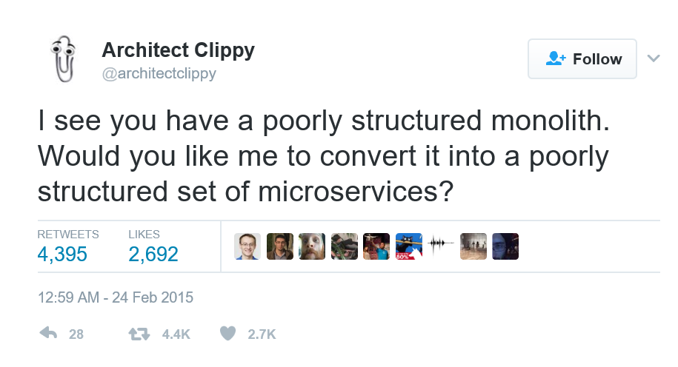

Slide 12
Call to action
Visit
Microsoft Azure docs
https://aka.ms/servicefabric
Read
Building Microservices:
Designing Fine Grained Systems
Follow
Joni Collinge
@dotjson

Slide 13
Thank you!

